Slide 1
Pls 2000 power & politics
Ideology:
Liberalism & Conservatism

Slide 2
Ideology:
Liberalism & CONSERVATISM
I. IDEOLOGY & ITS ORIGINS
II. LIBERALISM
III. CONSERVATISM
TERMS TO KNOW
Ideology Socialization
Primacy Principle Moral Foundations Theory
Liberalism Conservatism
Horseshoe Theory

Slide 3
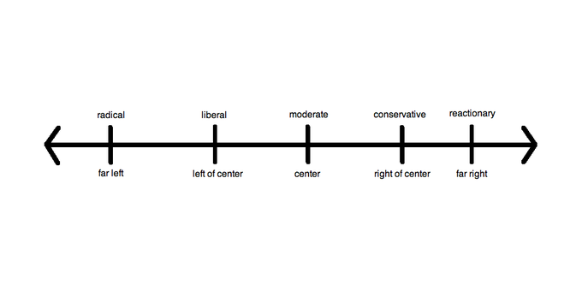
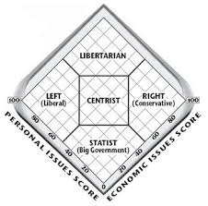
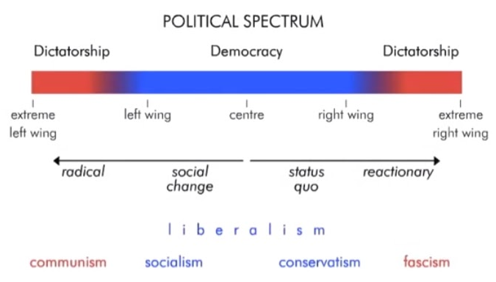
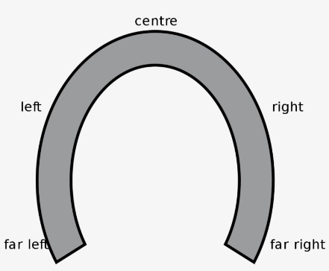
I. Ideology
  A system of values and beliefs about the proper purpose and scope of government
    “internally pluralistic, contested, complex & overlapping”
  Horseshoe Theory: extreme left and right exhibit similar tendencies regarding intolerance, individual rights, and the role of a strong state

Slide 4
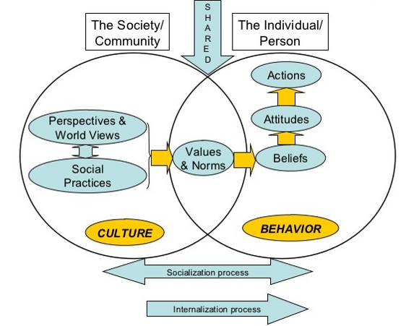
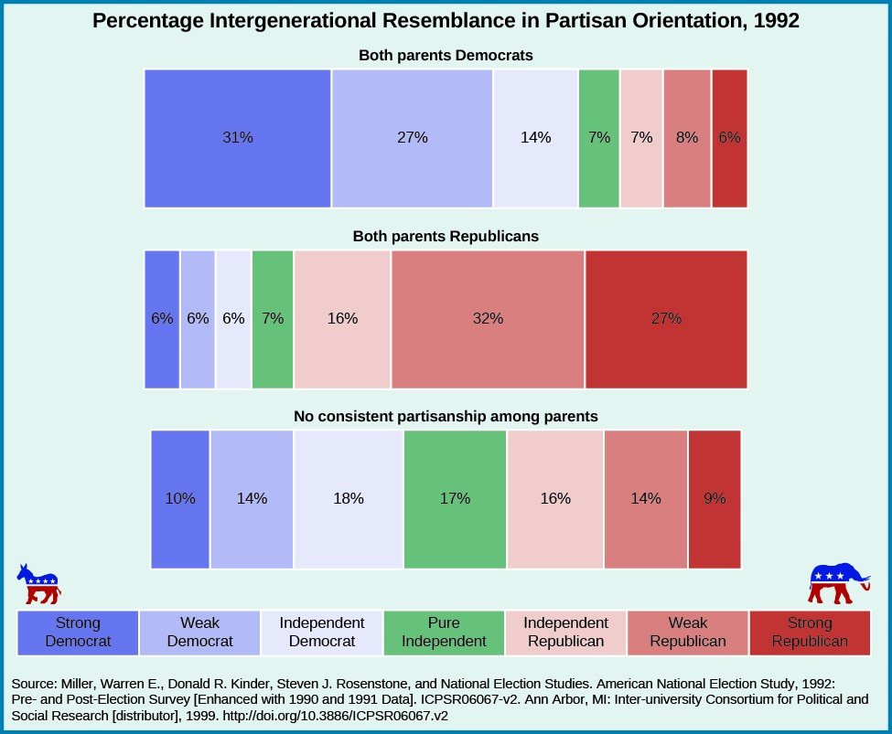
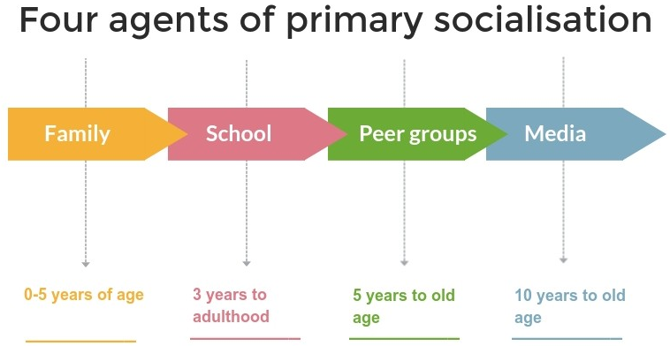
THE ORIGINS OF POLITICAL ATTITUDES
Socialization: process by which people acquire political attitudes
  Primacy Principle: Parents influence on children’s “immutable between generations & across lifetimes”
    Direct Trait-to-Trait Transmission
    “Youthful Change”: openness, rebellion, education (age 14-25)
http://blogs.lse.ac.uk/politicsandpolicy/money-makes-people-right-wing-and-inegalitarian/?utm_content=buffer0aa09&utm_medium=social&utm_source=twitter.com&utm_campaign=buffer
http://news.psu.edu/photo/381612/2015/11/19/political-affilifation
Notes:
Direct trait-to-trait: you become what political attitude your parents had
“youthful change”: you start thinking on your own and develop your own political attitudes (could be or not be the same as parents)

Slide 5
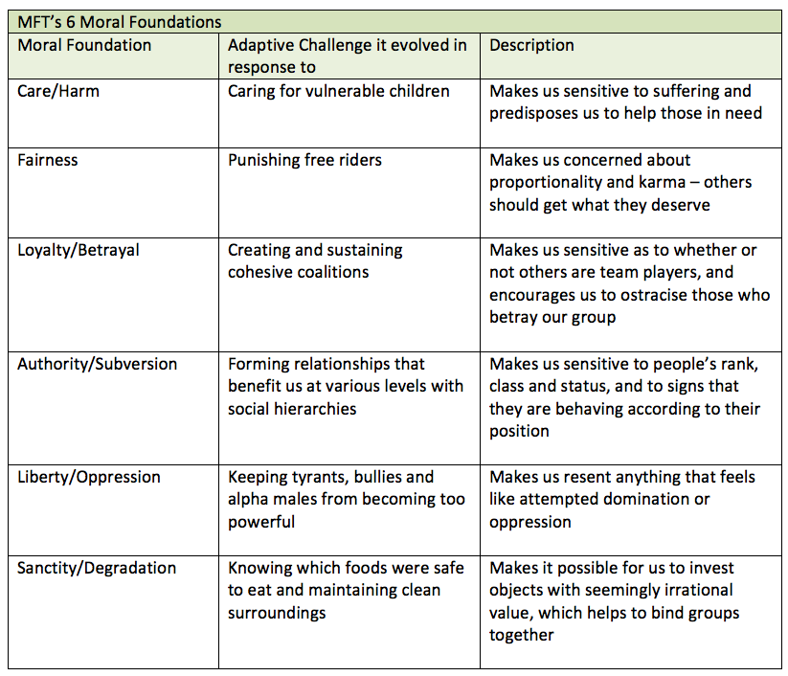
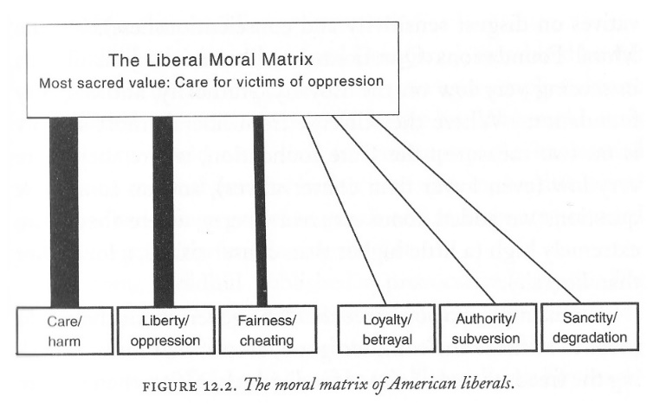
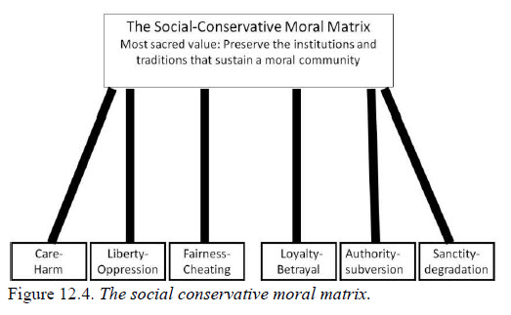
EVOLUTIONARY BASIS FOR IDEOLOGY?
Moral Foundations Theory (MFT)
Ideology is rationalization of visceral attitudes; ie. “long ago genetic mutations… hardwire ideology”
  “Parties are divided not by class or geography or education but by temperament”
Political orientations…mesh with broader tastes and preferences because they are part of the same biologically rooted inner self
  40% of variation in political beliefs is ultimately rooted in DNA (Hibbing)
MFT: six Moral Foundations are adaptive evolutionary responses to problems expressed in different combinations by individuals in the form of ideology

Slide 6
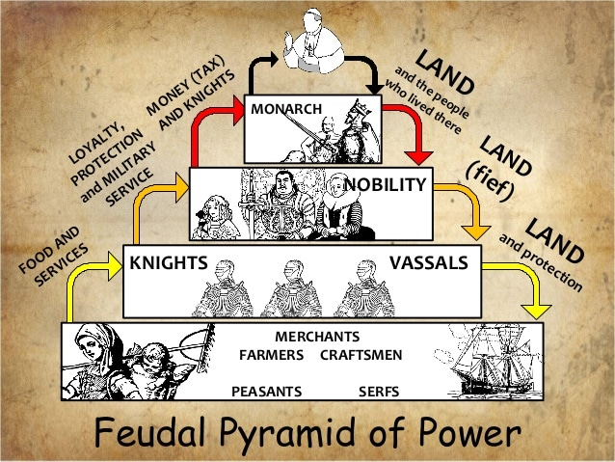
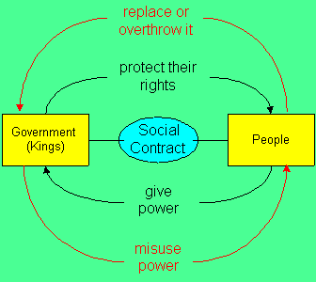
II. Liberalism
(p.120)
Ideology rooted in Rationalism and the Enlightenment: Trust in people and checked government power to maximize individual wellbeing and societal progress
  Political Liberty: Distrust of absolute power to represent people’s interests leads to social contract trading protections & rights for obedience, subject to accountability and the right to overthrow
    limited government through checks and balances
    Representative government through elections
  Religious Liberty
    Freedom of religion
    Freedom from religion, and power/extortion/corruption of the clergy
  Social Liberty
    No Nobility, Yes to Mobility
    Equality of Opportunity
  Economic Liberty
    Market based free enterprise for efficiency and growth
    Limited government regulation & “no taxation without representation”

Slide 7
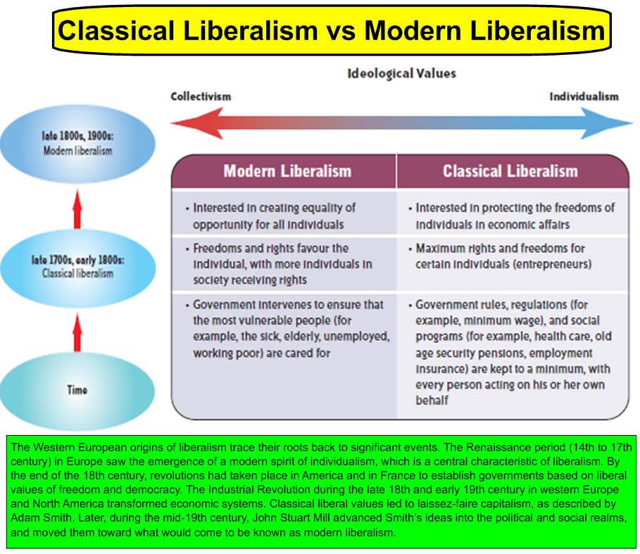
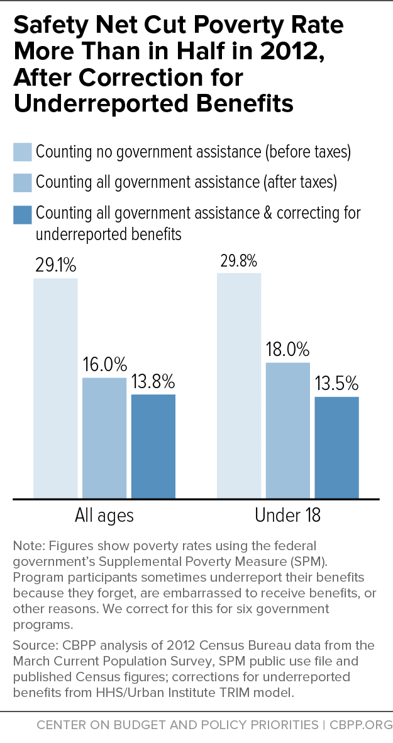
CLASSICAL VS. MODERN Liberalism
(p.121)
Modern Liberalism: More role for the state in the economy to correct market failures and “negative externalities” - the unintended costs and consequences that jeopardize peoples’ liberties or opportunities
      Break up Monopolies that dampen competition, decreasing efficiency and choice and increasing costs
      Labor Rights
      Standards & Regulations
      Minimum Wage
      Social Safety Nets
https://www.cbpp.org/research/poverty-and-inequality/examining-the-safety-net

Slide 8
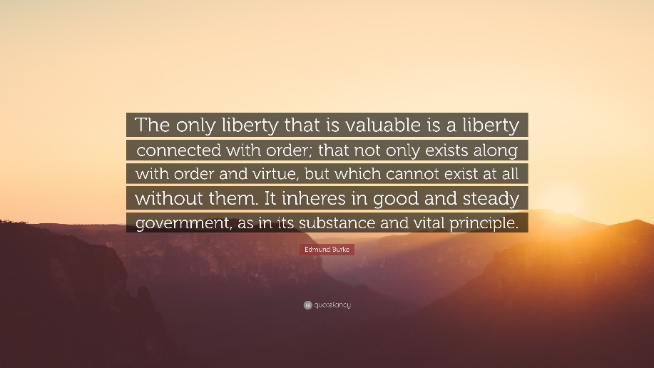
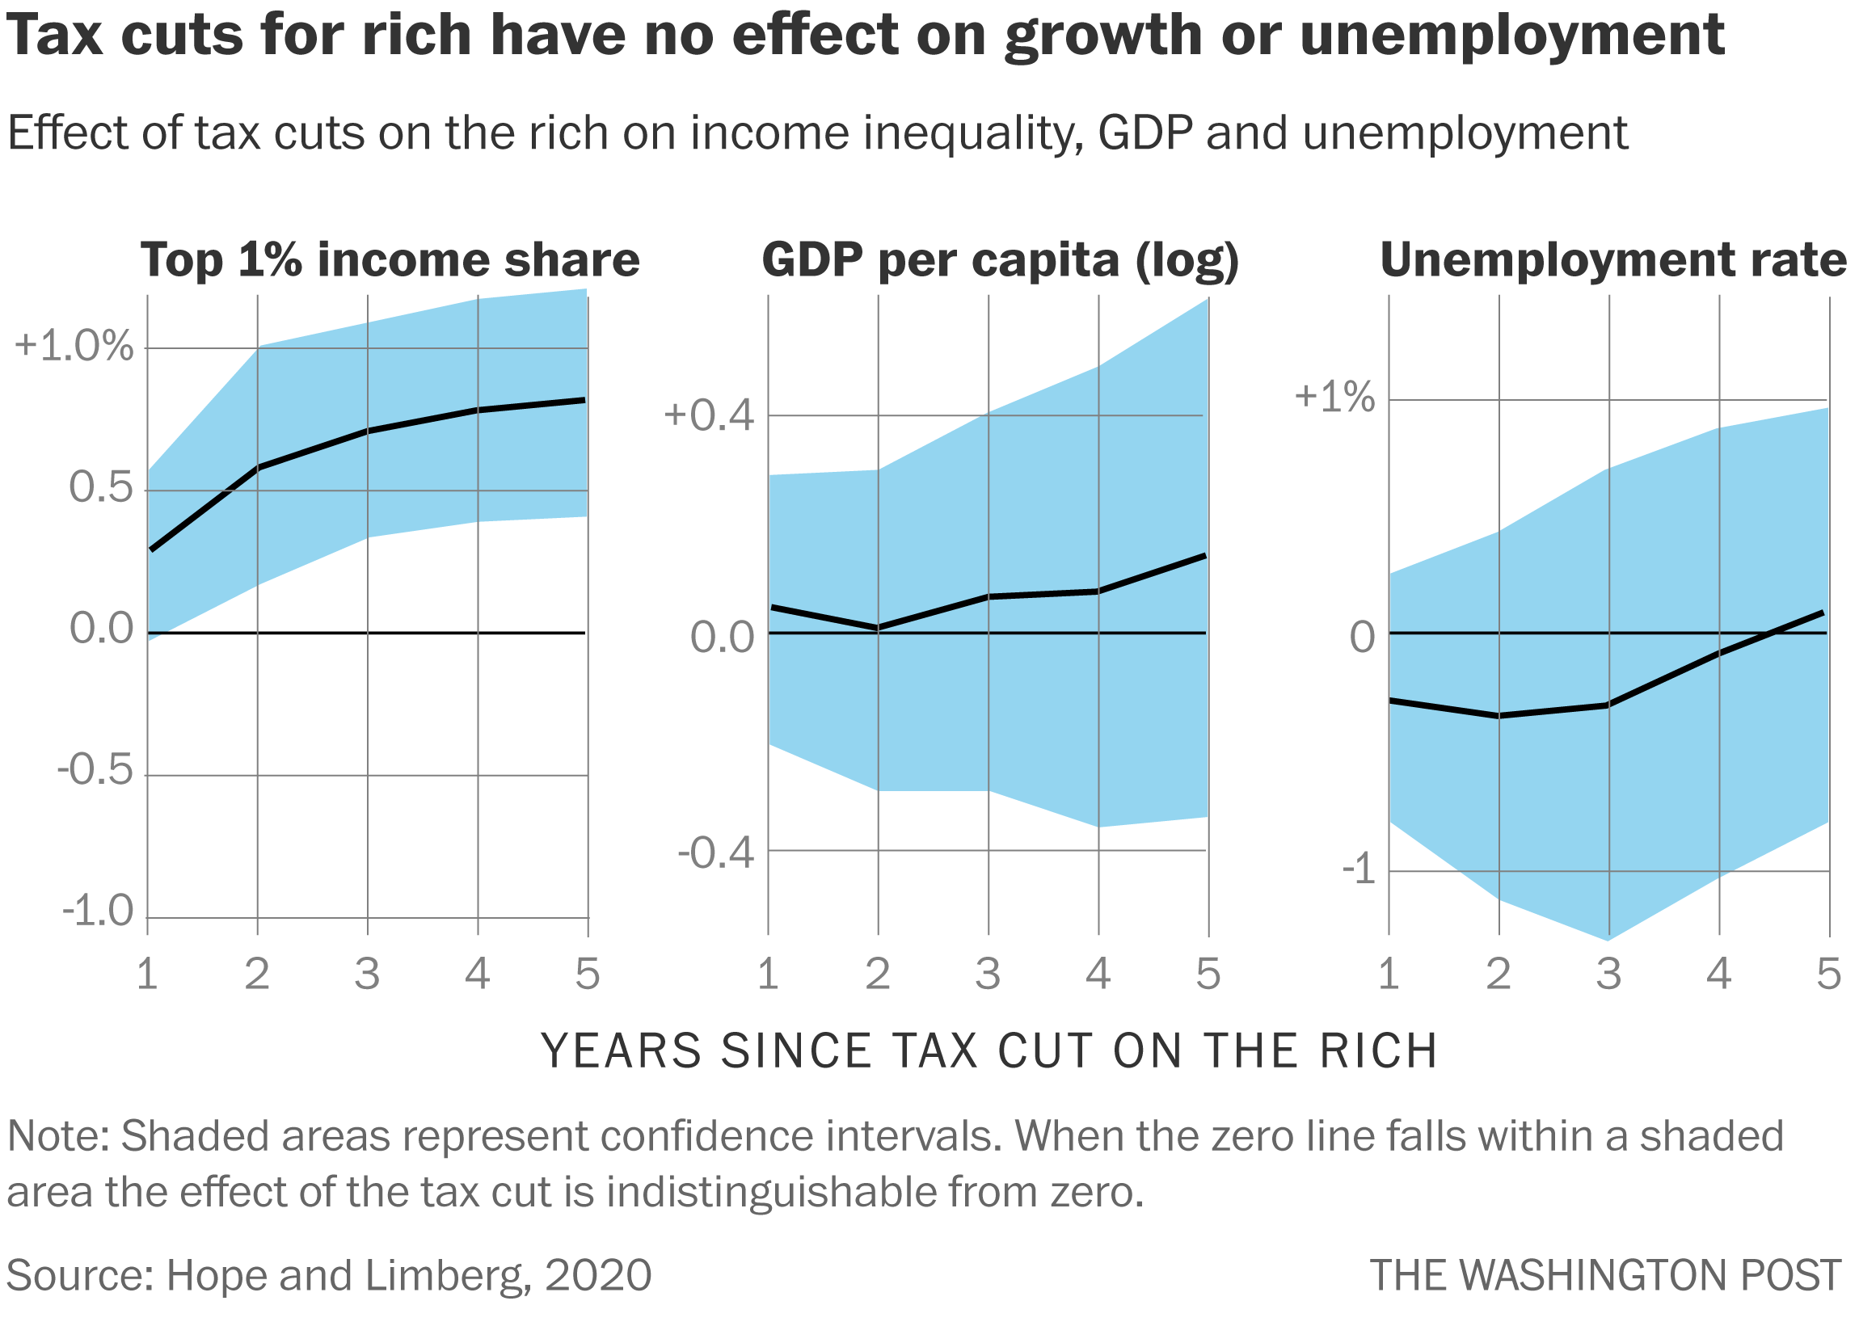
IiI. Conservatism
(p.128)
Skeptical of claims of abstract rights and freedoms promised by the progressive movements, without order and authority, and skeptical of the “rational” view of individuals
Emphasis on traditions over freedom of all behaviors and tolerance of all ideas that may have negative consequences to the social fabric by the pace and extent of change that ignores culture and tradition (“organicism”)
New Right conservatism: individualist economic freedoms and collective social traditions
  Neoclassical liberalism? (a) Tax cuts for workers to keep and spend what they earn as they see fit; and (b) tax cuts & deregulation to reward businesses to reinvest and hire more workers for societal growth (deregulation too)
https://www.washingtonpost.com/business/2020/12/23/tax-cuts-rich-trickle-down/

